Slide 1
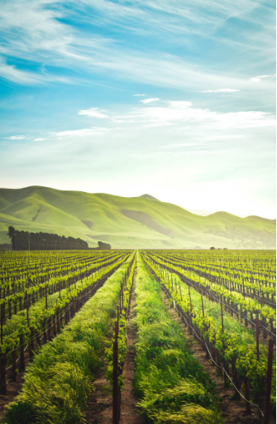
ARTIFICIAL INTELLIGENCE IN AGRICULTURE
GROUP NO - 15
Name Roll No
Anshul Choudhary 17CS10005
Harshit Soora 17CS10014
Abhik Naskar 17CS30001
Sahil Singh 17CS10047
Gurram Vasu 17CS30014

Slide 2
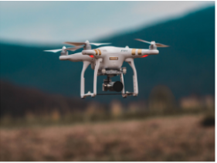
Contents
Introduction
Importance of AI in Agriculture
Robots in Agriculture
Automated Irrigation Systems
AI in Weed Detection
Drones in Agriculture
Crop Spraying
Crop Monitoring
Conclusion
References

Slide 3
INTRODUCTION
Anshul Choudhary | 17CS10005
Artificial Intelligence is a branch of computer science dealing with the simulation of intelligent behavior in computers.
Compared to the other industries, the agriculture sector has been slow to implement and take advantage of the variety of technologies.
Poor infrastructure and heavy regulatory burdens have raised the costs for food systems.

Slide 4
GREEN REVOLUTION
Anshul Choudhary | 17CS10005
The global population is expected to reach 10 billion people by 2050, which means double agricultural production in order to meet food demands which is about 70% increase in food production.
This means that the global agriculture sector is under more strain than ever with 2 billion more mouths to feed within the next 33 years.
Farm enterprises require new and innovative technologies to face and overcome these challenges.
By using AI we can resolve these challenges.

Slide 5
The Ways AI is shaping the farms of the future
Anshul Choudhary | 17CS10005
Drones
Providing new ways of increasing crop yields through in-depth field analysis, long-distance crop spraying and high-efficiency crop monitoring.
Driverless tractors
Combining ever-more sophisticated software with ‘0ff-the-shelf’ technologies such as sensors, radar and GPS systems.
Automated irrigation systems
Thankfully, though, automated irrigation systems are designed to utilize real-time machine learning to constantly maintain desired soil conditions to increase average yields.
Crop health monitoring
Conventional crop health monitoring methods are incredibly time-consuming and are categorical in nature.

Slide 6
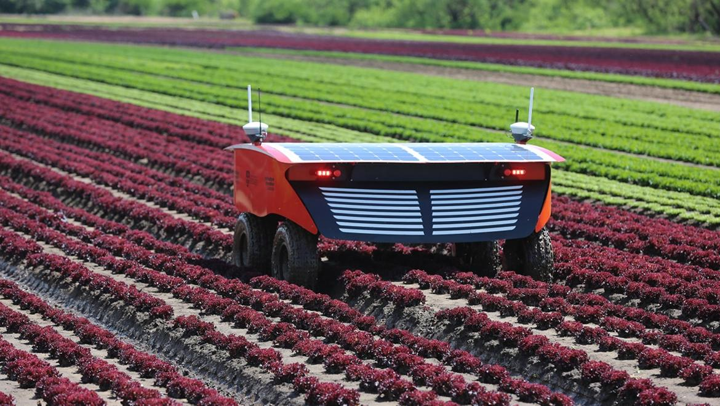
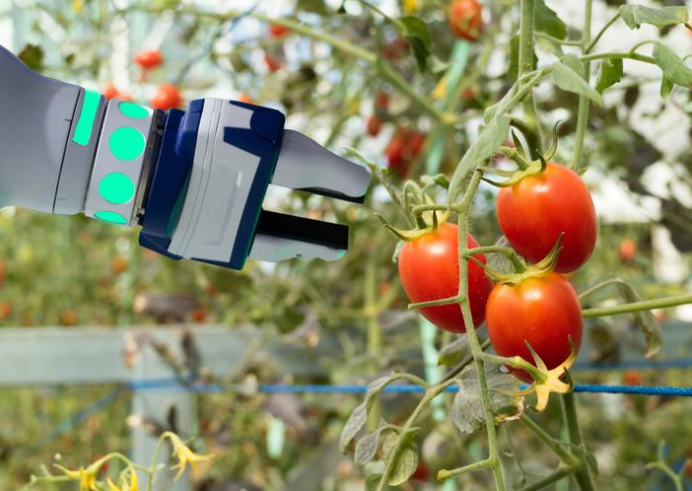
Abhik Naskar | 17CS30001
Robots in Agriculture - Irrigation
Presented By - Abhik Naskar(17CS30001)

Slide 7
Introduction
Abhik Naskar | 17CS30001
The UK Agri-Food chain, from primary farming through retail, generates over £108bn p.a., and with 3.7m employees in a truly international industry yielding £20bn of exports in 2016. Robotics has played a substantial role in the agricultural production and management.
The robots are performing various agricultural operations autonomously such as weeding, irrigation, guarding the farms etc.
The main purpose of coming up with this technology is to replace human labor and produce effective benefits on small as well as large scale productions.
Presented By - Abhik Naskar(17CS30001)

Slide 8
Brief History and Inception
Abhik Naskar | 17CS30001
The idea of coming up with such a technology came with the introduction of a machine called Eli Whitney's cotton gin which gave birth to autonomous agricultural robots.
A basic automated model was introduced to determine the actual position of seeds . Ultra high precision placement of seed was also established.
The status or the development of plant were recorded by automated machines. For the effective use of water, automated irrigation systems were also established.
Presented By - Abhik Naskar(17CS30001)

Slide 9
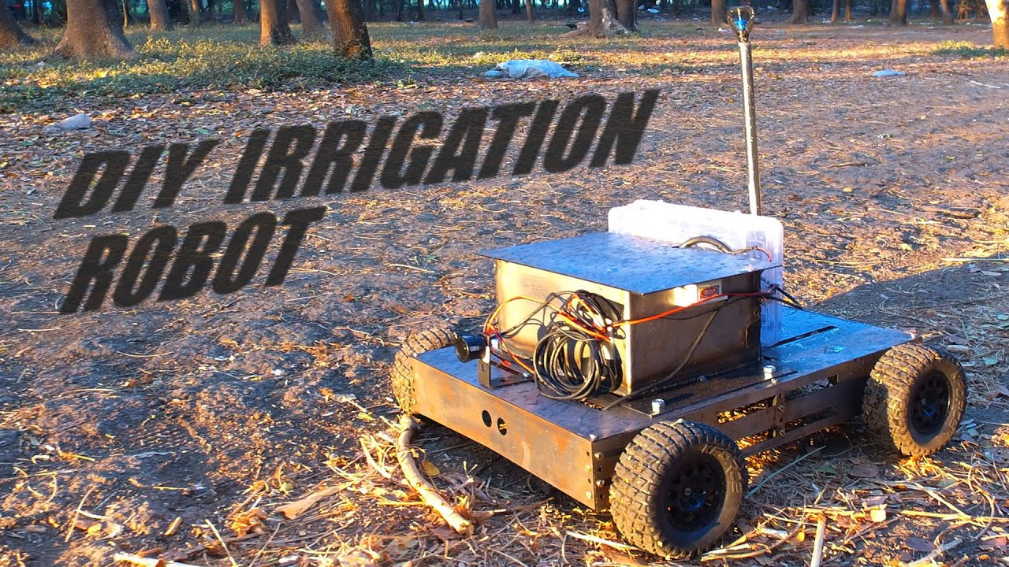
Automated Irrigation Systems
Abhik Naskar | 17CS30001
Motivation : come up with more efficient technologies in order to ensure proper use of water resources in irrigation.
The plant evapotranspiration which was dependent on various atmospheric parameters such as humidity, the wind speed, solar radiations and even the crop factors such as the stage of growth, plant density, the soil properties, and pest was taken into consideration while implementing autonomous irrigation machines.
Action : In 2017 researchers developed an automated robotic model for the detection of the moisture content and temperature of the Arduino and Raspberry pi3. The data is sensed at regular intervals and is sent to the microcontroller of Arduino (which has an edge level hardware connected to it), it further converts the input analog to digital. The signal is sent to the Raspberry pi3 (embedded with KNN algorithm) and it sends the signal to Arduino to start the water source for irrigation - The M2M(Machine to Machine) Model
Various other researchers came up with their automated robotic model for efficient and automated irrigation system like Savitha and UmaMaheshwari(2018), Varatharajalu and Ramprabhu(2018) etc. are few to be mentioned.
Presented By - Abhik Naskar(17CS30001)

Slide 10
Abhik Naskar | 17CS30001
No. | Algorithms | Method of Evapotranspiration | Other Technologies | Advantage/Results
 | PSLR and other regression models | Evapotranspiration model | Sensors for data collection, IOT HW Implementation. | Increased efficiency and economic feasibility
2. | Artificial Neural Network based control system | Evapotranspiration model | Sensors for measurement of soil,temperature,wind speed, etc. | Automation
3. | Fuzzy Logic | FAO Penman- Monteith method |  | Optimization
4. | ANN (multilayer neural model), Levenberg Marquardt, Backpropagation | Penman–Monteith method |  | Evaporation decreased due to schedule and savings observed in water and electrical energy.
5. | Fuzzy Logic |  | WSN, Zigbee | Experimental results verification. Can be applied to home gardens and grass
6. | ANN |  |  | Optimization of water resources in a smart farm.
7. | Fuzzy Logic Controller | Penman–Monteith method | Wireless sensors | Drip irrigation prevents wastage of water and evaporation
8. | Machine Learning algorithm |  | Sensors, Zigbee, Arduino microcontroller | Prediction and tackles drought situations.

Slide 11
AI in Weed Detection
Gurram Vasu | 17CS30014

Slide 12
Motivation
Gurram Vasu | 17CS30014
In recent years, weeds have been responsible for most agricultural yield losses. To deal with this threat, farmers resort to spraying the fields uniformly with herbicides. This method not only requires huge quantities of herbicides but impacts the environment and human health.
One way to reduce the cost and environmental impact is to allocate the right doses of herbicide to the right place and the right time (precision agriculture).

Slide 13
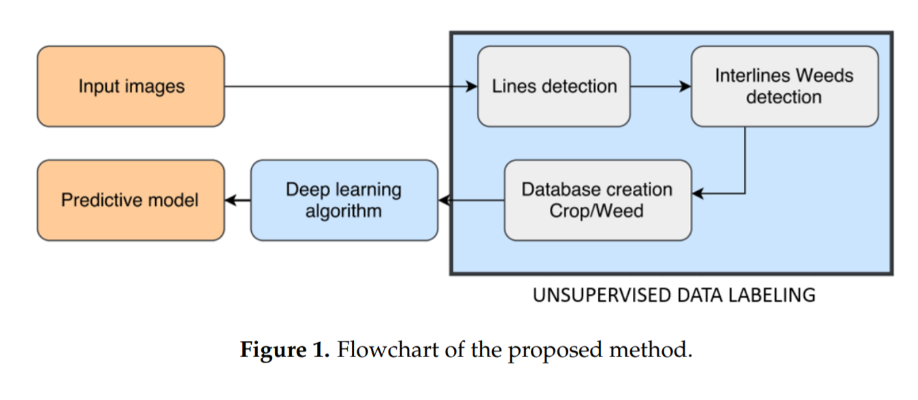
Proposed method ( 3 steps )
Gurram Vasu | 17CS30014

Slide 14
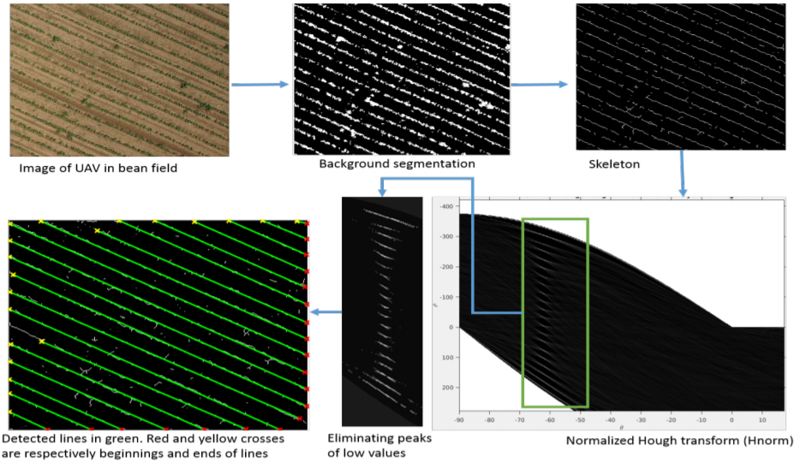
Step 1 : Detection of Crop Lines
Gurram Vasu | 17CS30014

Slide 15
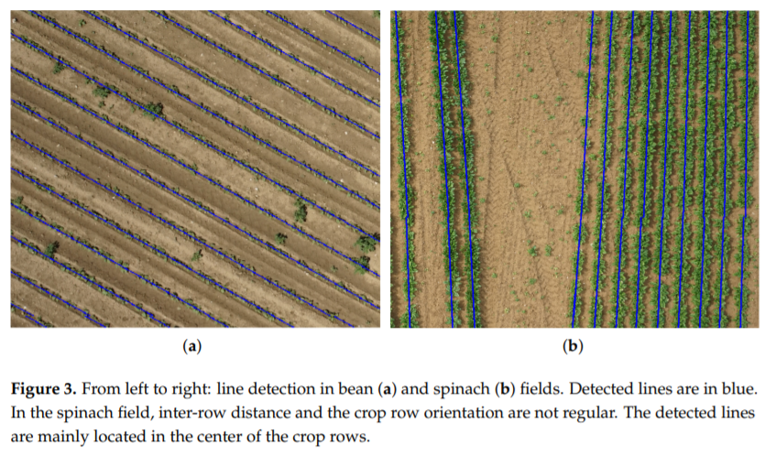
Step 2 : Unsupervised Training Data Labelling
Gurram Vasu | 17CS30014

Slide 16
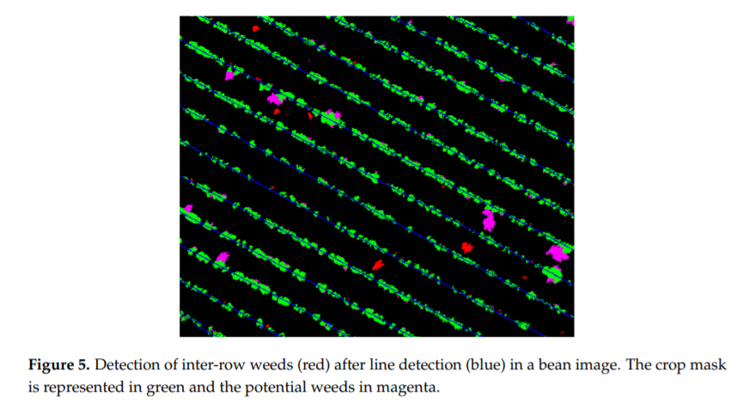
Detection of Inter-row weeds
Gurram Vasu | 17CS30014

Slide 17
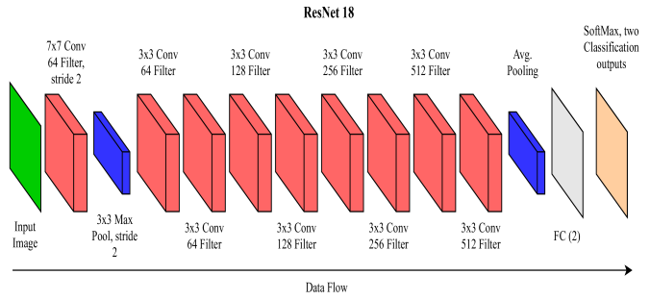
Step 3 : Generate a deep learning model
Gurram Vasu | 17CS30014
ResNet18 Convolutional Neural Network
Transfer Learning

Slide 18
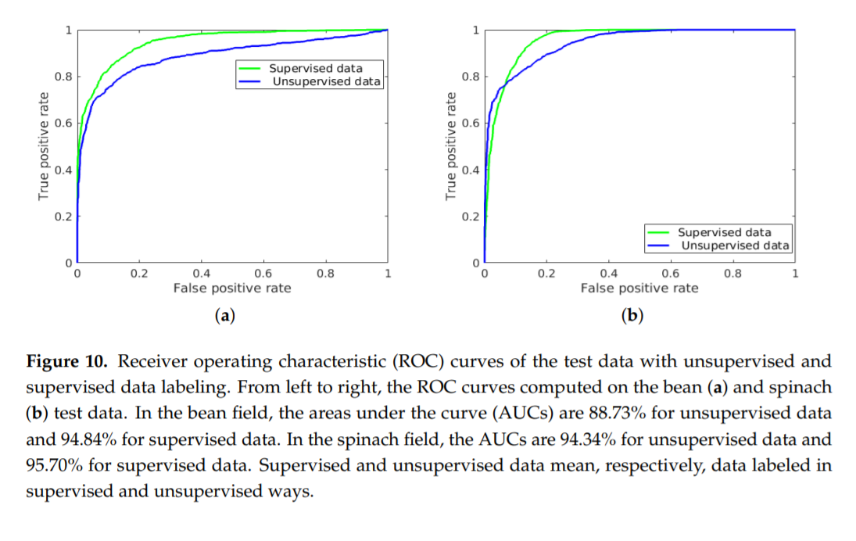
Result and conclusions
Gurram Vasu | 17CS30014

Slide 19
AI Drones in Spray Control Systems
Sahil Singh | 17CS10047

Slide 20
Intro
Sahil Singh | 17CS10047
Spray rates for drone systems are around 1-2L/ha, which is 25-50 times lower than conventional spray application systems
Manual pesticide spraying causes many harmful side effects to the person involved in the spraying process

Slide 21
Background
Sahil Singh | 17CS10047
To leverage drone technology fully as a spraying platform, the spraying needs to be paired and synchronized with imaging, processing & automated analytic capabilities in order to address the affected areas with precision.
Such an approach would lead not only to the improvement of dosage in the affected areas, but also leads to a reduction in the overall use of chemicals within the area.

Slide 22
Based on force required to atomize the shower liquid, sprayers are arranged into
Sahil Singh | 17CS10047
Hydraulic Energy Sprayer
Gaseous Energy Sprayer
Centrifugal Energy Sprayer
Kinetic Energy Sprayer

Slide 23
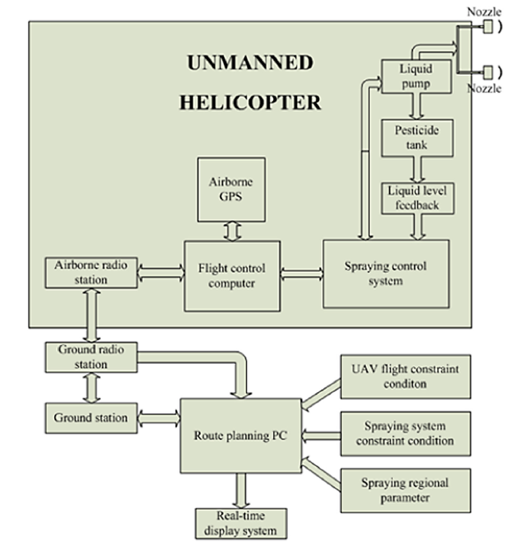
Spray Control System Architecture
Sahil Singh | 17CS10047

Slide 24
Drones in Crop Monitoring
Harshit Soora | 17CS10014

Slide 25
Intro
Harshit Soora | 17CS10014
A close eye on crop growth
Spread Analysis
Time and Resources
Future Planning

Slide 26
Yield Mapping and Monitoring
Harshit Soora | 17CS10014
A drone with a microcontroller to manage two Cameras one RGB and other sensitive to Infrared
These assist farmer in maximising their harvest by detecting problems early, and managing the crops by passing above captured data to detect Pests and Water Shortage
Technologies Incorporated in Harvesting
Grain Flow Sensor
Grain Moisture Content Sensor
GPS Receiver and Odometer
Header Position Sensor

Slide 27
Yield Calculation and Calibration
Harshit Soora | 17CS10014
Yield is characterized as harvest weight (lbs for cotton) or volume (grains) reaped per unit region, which is in a roundabout way estimated by the yield sensor
Stream rate/(speed x swath width)
Yield stream rate is commonly determined each 1–2 s during collecting
Further Steps
Data Transfer and Storage
Match it with collected from Drone
Machine Learning to Train and Test
Prediction for Next Year

Slide 28
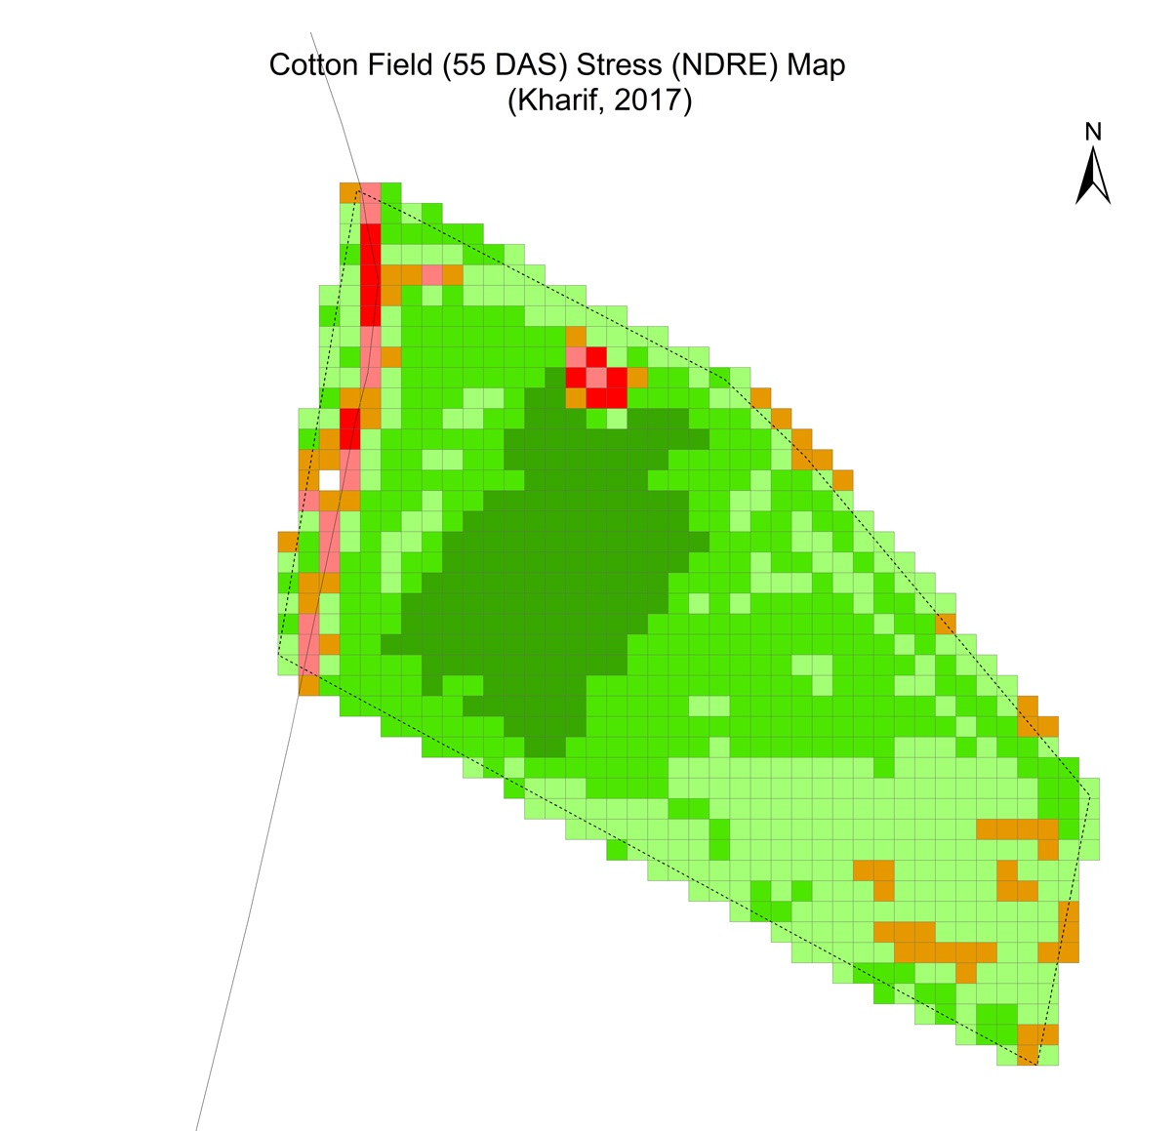
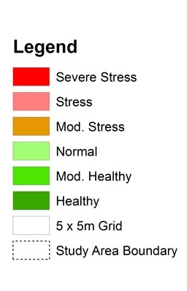
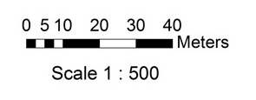
Yield Maps
Harshit Soora | 17CS10014
Geographical Information System
The yield determined at each field areas can be shown as--

Slide 29
CONCLUSION
Anshul Choudhary | 17CS10005
AI can be appropriate and efficacious in agriculture sector as it optimises the resource use and efficiency.
It solves the scarcity of resources and labour to a large extent. Adoption of AI is quite useful in agriculture.
Artificial intelligence can be technological revolution and boom in agriculture to feed the increasing human population of world.
Artificial intelligence will complement and challenge to make right decision by farmers.

Slide 30
References
Anshul Choudhary | 17CS10005
Tanha Talaviya, Dhara Shah, Nivedita Patel, Hiteshri Yagnik, Manan Shah. Implementation of artificial intelligence in agriculture for optimisation of irrigation and application of pesticides and herbicides. https://doi.org/10.1016/j.aiia.2020.04.002
The future of food and agriculture: Trends and challenges - Food and Agriculture Organization of the United Nations, ISSN 2522-722X, Rome, 2017
Journal - Artificial Intelligence in Agriculture (Science Direct). https://www.sciencedirect.com/journal/artificial-intelligence-in-agriculture
Artificial Intelligence in Agriculture - Dhaval Jadav. https://medium.com/datadriveninvestor/artificial-intelligence-in-agriculture-62f71f8f6ae6.
Develop an unmanned aerial vehicle based automatic aerial spraying system. http://dx.doi.org/10.1016/j.compag.2016.07.022

Slide 31
THANK YOU

